Slide 1


UTA EE LABS
Using IR to Transmit and Receive data

Slide 2
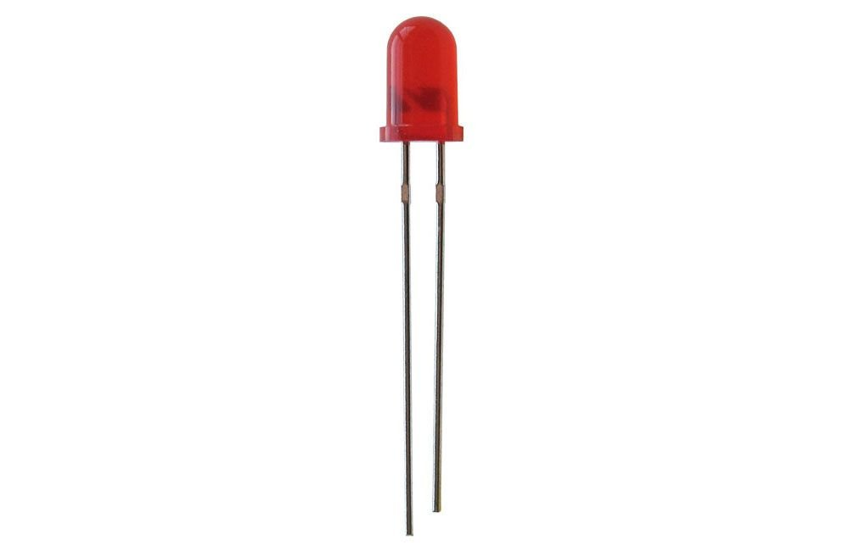
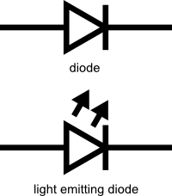
LED Basics
Common 5mm LED
The LED is a very low energy light source
Anode
Cathode
+
-

Slide 3
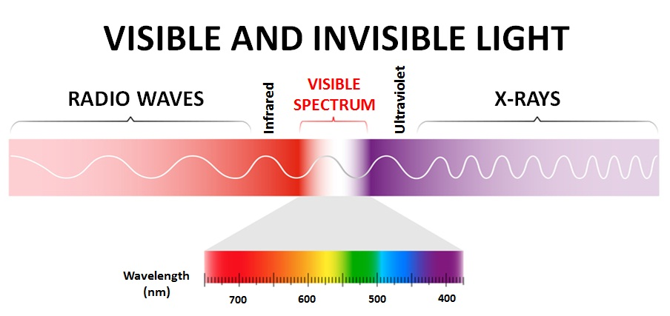
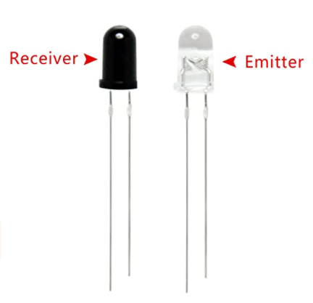
IR LED’s

Slide 4
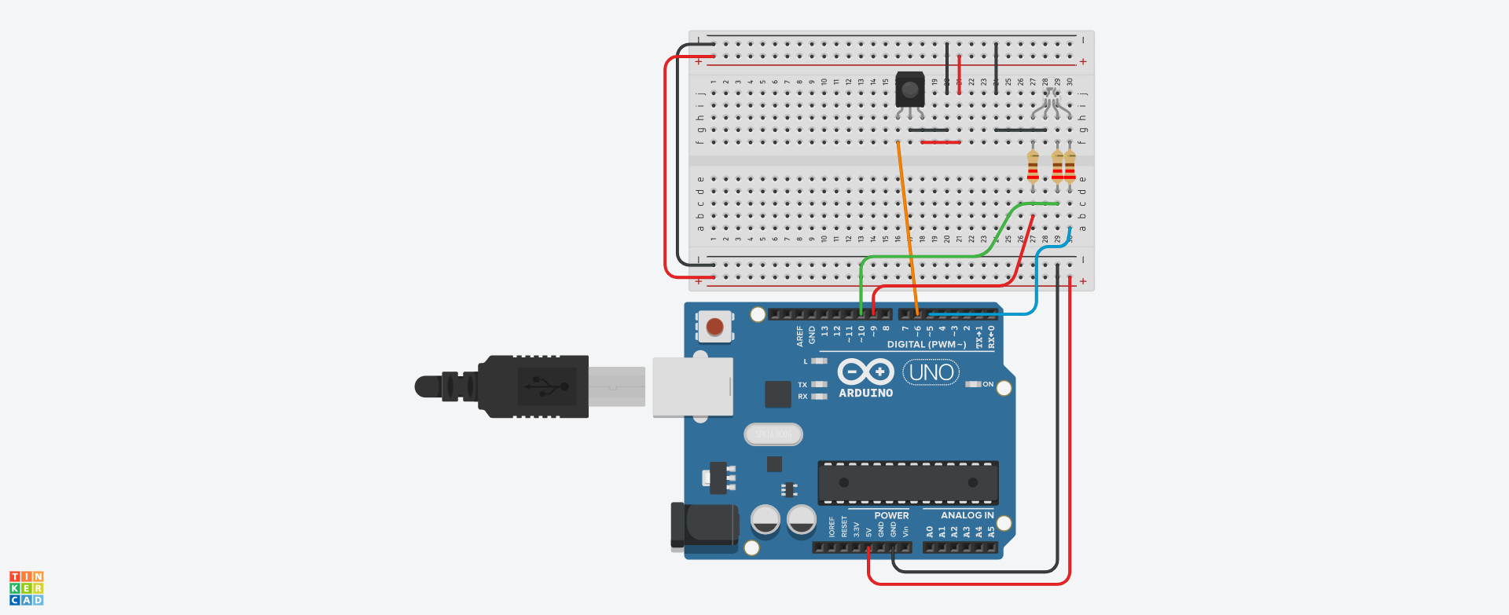
Let’s build the first circuit

Slide 5
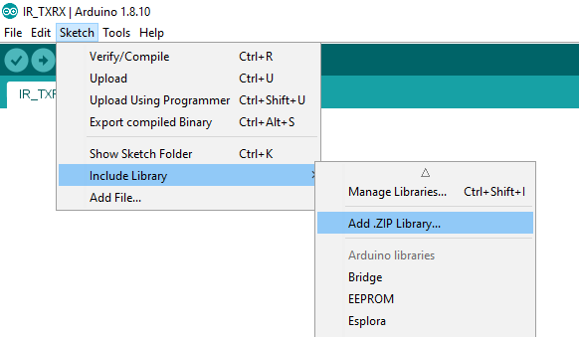
Arduino Libraries
We need to include a library to make our IR work.
Download the following zip file from https://downloads.arduino.cc/libraries/github.com/z3t0/IRremote-3.4.0.zip
Save it to Documents\Arduino\Libraries
Do not unzip.
Add from Sketch->Include Library-> Add .ZIP Library.

Slide 6
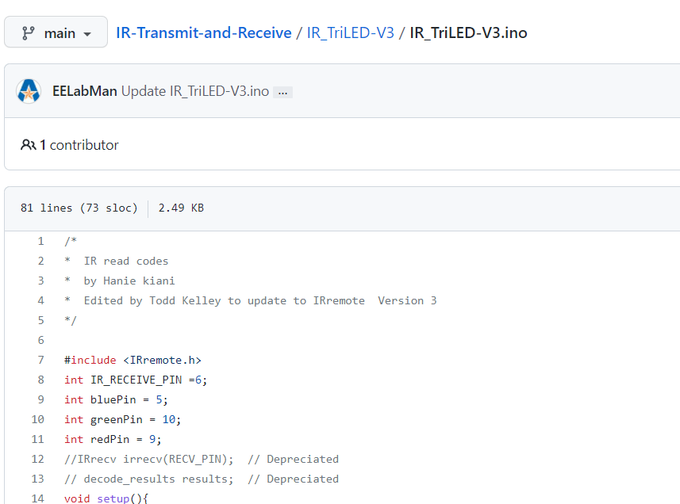
Code is downloadable from GitHub
https://github.com/EELabMan
IR-Transmit-and-Receive
IR_TriLED-V3
Open .ino file

Slide 7
Upload the code and Test
Pressing 1 on the remote should turn on the Red LED
Pressing 2 on the remote should turn on the Green LED
Pressing 3 on the remote should turn on the Blue LED
Pressing 4 on the remote should turn on the All the LEDs

Slide 8
IR Transmit
Out of time.

